Slide 1



How AIM Mutual Transformed
Receivables Processing
Trea$ury Initiatives 2018

Slide 2






Industry Experts
Leilani Doyle
SVP Product Management
U.S. Dataworks
Tom Drunsic
Founder
Lighthouse Payment Systems
Steven Privitera
Insurance Operations Manager
A.I.M. Mutual

Slide 3


Today’s Remittance Challenge
Multiple Payment Sources
Exception
Processing
Archive Access / Client Support
High Cost of A/R Reconcilement
Notes:
Payments coming in from multiple sources, including paper. Let’s face it the majority of the paper and lockbox payments that are coming are difficult to automate. This leads to a high number of exception items that require tedious manual intervention.

Slide 4
Entire Industry Impacted
IR Simplifies Payment Processing

Slide 5

How Can You
Achieve these results?
Take a strategic approach – technology, integration, learning and expansion

Slide 6
Implementation
“Solid Implementation Approach
is Key to Success”

Slide 7



Slide 8
Implementation
Data Requirements
Data Sources
Source data for matching and A/R file build
  Searching – Data to find a transaction
  Matching – Data required to identify a transaction
  A/R file – Data needed to build the posting file
What transactions to process
Statement file
Billing file
Emails
Notices
Timing
Checks (through Lockbox)
ACH
Wires
Invoice uploads
Processing schedule

Slide 9




Communicating Data
Upload through Web Portal
FTP or SFTP
FTP
Point to Point File Sync

Slide 10
The Process
Find Defined Match Elements
Image analysis
Scanline
Data entry
Match Successful
Append additional A/R data
Match Unsuccessful
Send to Online Exceptions
Manually perform match
Append A/R data
Remember transaction (Learn)
Full page OCR
Email text
Key fields matched
No manual intervention

Slide 11
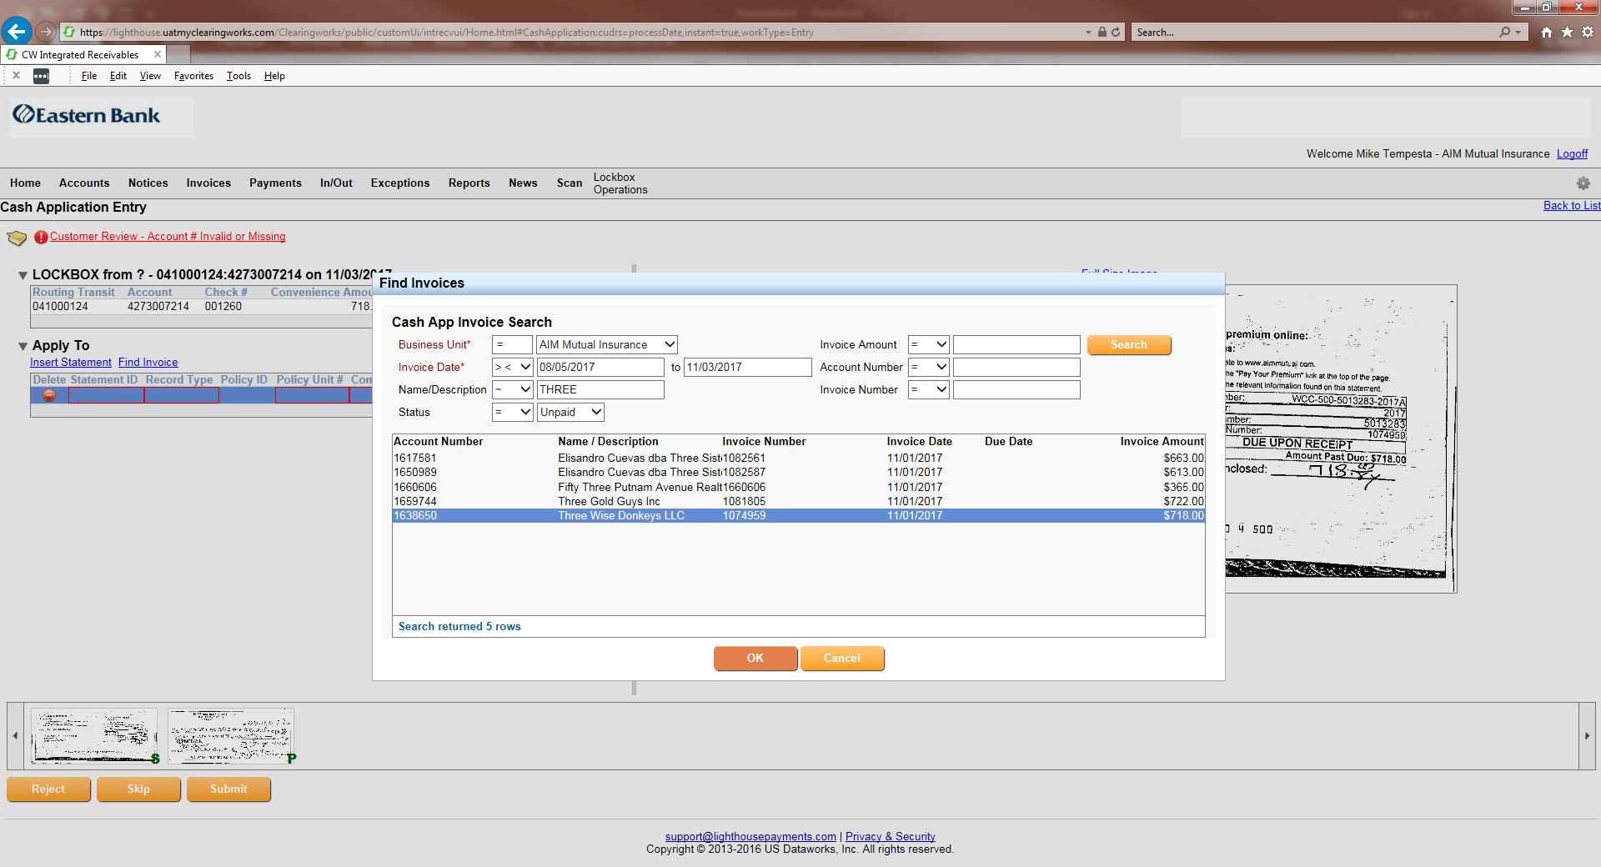

Ac
Three Musketeers Plumbing
Fifty Three Main Street Trust
Three Guys Painting
Strike Three Bail Bondsmen
One Two Three Salon
Selecting the proper record from the results and click ‘OK’.

Slide 12
The Process
Find Defined Match Elements
Image analysis
Scanline
Data entry
Match Successful
Append additional A/R data
Match Unsuccessful
Send to Online Exceptions
Manually perform match
Append A/R data
Remember transaction (Learn)
Full page OCR
Email text
Key fields matched
No manual intervention

Slide 13
Transformation
“The World of Remittance is
Rapidly Changing”

Slide 14


At A.I.M. Mutual Insurance Companies, we are committed to setting the standard in service excellence.
We are guided by our founding principles to stabilize workers compensation costs and make them predictable for Massachusetts, New Hampshire, Vermont, and Connecticut employers.

Slide 15




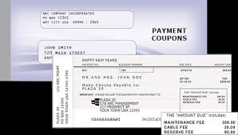
Old Posting Process
Check and remittance images were received daily from Lighthouse
Cash Application team downloaded to local PC and printed reports
Manually entered all applicable information to complete processing

Slide 16


Old Posting Process
Payments required manual effort to post
Cash Application took 4 hours daily, 20 hours a week, 1040 a year

Slide 17
Big Impact for A.I.M. Mutual
Time spent on Cash Application was reduced to 3 hours per week
Accuracy improved with automation
Less manual intervention allowed for more cross-training
Manual entry was reduced to 1 or 2 pieces of information on a small percent of payments
Approximately 1.3 minutes per exception item

Slide 18
Actual results post transformation
 | Exceptions | Time (Minutes)
01/31/18 | 73 | 68
02/01/18 | 55 | 60
02/02/18 | 125 | 60
02/05/18 | 475 | 119
02/06/18 | 6 | 6
02/07/18 | 34 | 32
02/08/18 | 31 | 40
02/09/18 | 30 | 17
02/13/18 | 97 | 126
02/14/18 | 6 | 9
02/15/18 | 31 | 27
02/16/18 | 18 | 16
02/20/18 | 88 | 78
02/21/18 | 2 | 2
02/22/18 | 24 | 39
02/23/18 | 11 | 13
02/26/18 | 76 | 51
02/27/18 | 16 | 11
02/28/18 | 19 | 24
03/01/18 | 18 | 22
03/02/18 | 21 | 27
03/05/18 | 63 | 47
03/06/18 | 11 | 11
03/07/18 | 7 | 10
03/09/18 | 37 | 56
03/12/18 | 74 | 66
03/14/18 | 20 | 27
03/15/18 | 7 | 26
03/16/18 | 32 | 32
03/19/18 | 84 | 71
Total | 1591 | 1193

Slide 19
Expansion
Building on a Solid Platform

Slide 20







Payments Require Manual Processing
Business Bill Pay
Biller
Inbound Credit - $512.37
Vendor Bill Pay - $512.37
Payment and Payment Information Not Always Together
ACH Clearing
ACH
Online Banking
Manual Reconciliation and Entry
Billing System
Remittance Notification
(e-mail, file, etc.)
E-mail Service
Inbound email – Invoice 16729 paid via ACH

Slide 21

Where is the Future
Taking Us?
New Real Time Payments will create new pieces in the remittance puzzle.

Slide 22

Questions
or Ideas?

